Slide 1
Interoperability Technology in Healthcare
- Sharv Kulkarni
Stevens Institute of Techonlogy

Slide 2
Introduction
What is interoperability?
Evolution of interoperability
FHIR
TEFA+QHINs

Slide 3
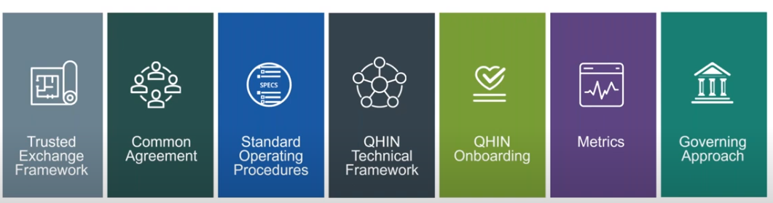
Trusted Exchange Framework and Common Agreement (TEFCA)
Need for TEFCA
How TEFCA revolutionizes interoperability
QHIN and QTF
Architecture and working principles

Slide 4
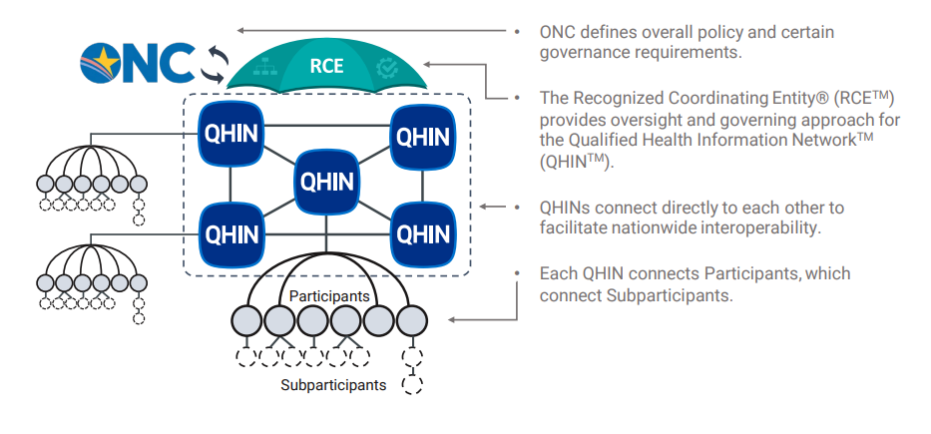
Trusted Exchange Framework and Common Agreement (TEFCA)

Slide 5
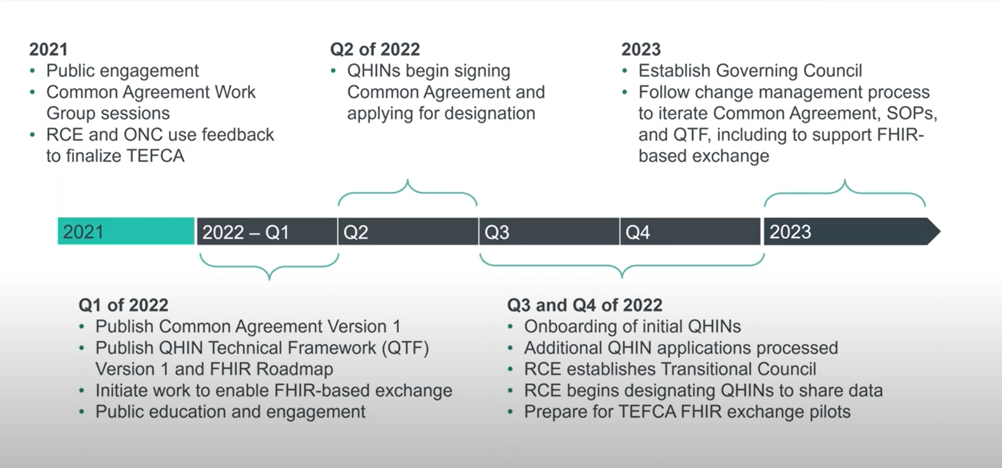
Trusted Exchange Framework and Common Agreement (TEFCA)

Slide 6

Fast Healthcare Interoperability Resource (FHIR)
A robust data model for describing health and administrative data
A RESTful API for interacting with that data using JSON or XML
A set of open-source tools to implement and test FHIR applications
A community of implementers working together.

Slide 7
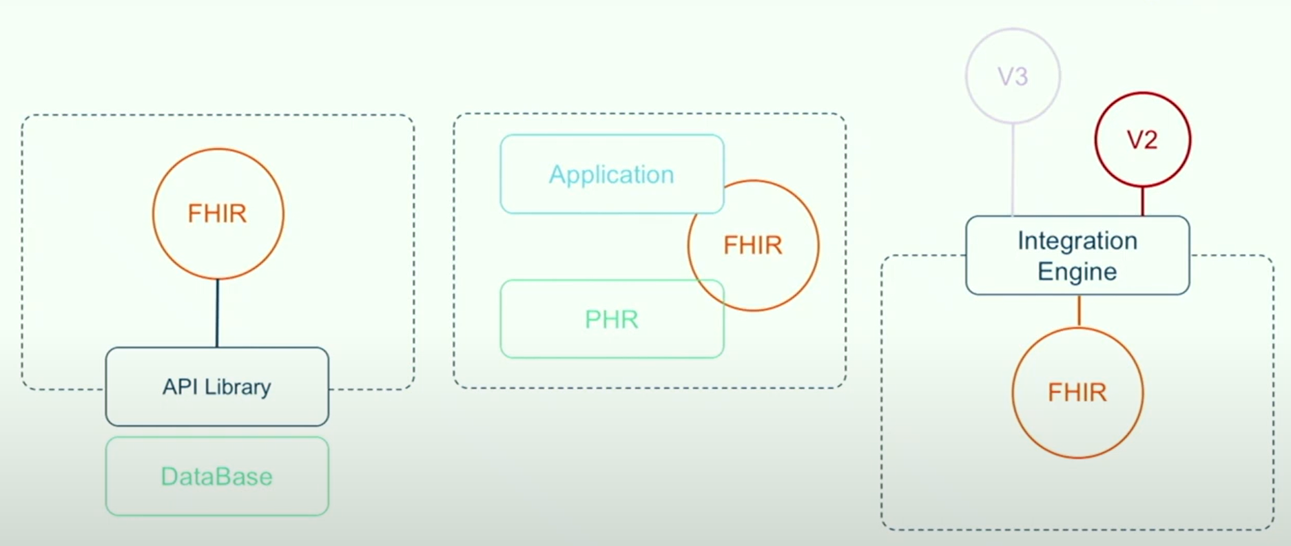
Fast Healthcare Interoperability Resource (FHIR)
Data model
Data types
Resources
Extensions
Serialization
Exchange model
Rest API
Searchability
Security
Subscriptions

